Slide 1
LIBRARY MANAGEMENT SYSTEM
NIVED SUDHINDRAN
03/NOV/2024

Slide 2
Library Management System
You are going to build a project based on the Library Management System. It keeps track of all information about books in the library, their cost, status, and total number of books available in the library.
Create a database named library and following TABLES in the database:
    Branch
    Employee
    Books
    Customer
    IssueStatus
    ReturnStatus

Slide 3

Table : Branch
Attributes for the tables
Branch_no - Set as PRIMARY KEY, Manager_Id, Branch_address, Contact_no
CREATE TABLE Branch( Branch_no VARCHAR(20) PRIMARY KEY, Manager_Id VARCHAR(20) UNIQUE, Branch_address VARCHAR(50), Contact_no BIGINT UNIQUE);
INSERT INTO Branch values
('LIB-001',1001,'BANK ROAD, KANNUR',914972300001),
('LIB-002',2001,'NETAJI ROAD, KANNUR',914972500001);

Slide 4
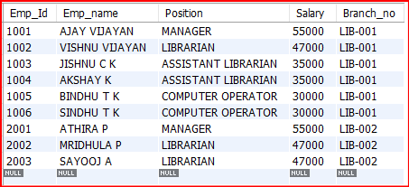
Table : Employee
Attributes for the tables
Emp_Id – Set as PRIMARY KEY, Emp_name, Position, Salary, Branch_no - Set as FOREIGN KEY and it refer Branch_no in Branch table
CREATE TABLE Employee( Emp_Id INT PRIMARY KEY, Emp_name VARCHAR(40), Position VARCHAR(40), Salary INT, Branch_no VARCHAR(20), FOREIGN KEY (Branch_no) REFERENCES Branch(Branch_no));
INSERT INTO Employee VALUES
(1001,'AJAY VIJAYAN','MANAGER',55000,'LIB-001’),
(1002,'VISHNU VIJAYAN','LIBRARIAN',47000,'LIB-001’),
(2001,'ATHIRA P','MANAGER',55000,'LIB-002’),
(1003,'JISHNU C K','ASSISTANT LIBRARIAN',35000,'LIB-001’),
(1004,'AKSHAY K','ASSISTANT LIBRARIAN',35000,'LIB-001'),
(1005,'BINDHU T K','COMPUTER OPERATOR',30000,'LIB-001'),
(1006,'SINDHU T K','COMPUTER OPERATOR',30000,'LIB-001’),
(2002,'MRIDHULA P','LIBRARIAN',47000,'LIB-002'),
(2003,'SAYOOJ A','LIBRARIAN',47000,'LIB-002');

Slide 5
Table : Books
Attributes for the tables
ISBN - Set as PRIMARY KEY, Book_title, Category, Rental_Price, Status [Give yes if book available and no if book not available], Author, Publisher
CREATE TABLE Books( ISBN VARCHAR(20) PRIMARY KEY, Book_title VARCHAR(100) NOT NULL, Category VARCHAR(50) NOT NULL, Rental_Price INT NOT NULL, Status VARCHAR(3) DEFAULT 'YES', Author VARCHAR(50), Publisher VARCHAR(50));
INSERT INTO Books (ISBN , Book_title , Category , Rental_Price,Author,Publisher ) VALUES
('BOOK-000001','TWILIGHT','Fantasy / Romance', 80,'Stephenie Meyer','Little, Brown and Company’),
('BOOK-000002','To Kill a Mockingbird','Fiction / Classic', 22,'Harper Lee','Charles Scribner\'s Sons’),
('BOOK-000003','A Brief History of Humankind','Non-Fiction / History', 100,'Yuval Noah Harari','Harper’),
('BOOK-000004','The Silent Patient','Thriller / Mystery', 70,'Alex Michaelides','Celadon Books’),
('BOOK-000005','The Great Gatsby','Fiction / Classic', 90,'F. Scott Fitzgerald','Random House’),
('BOOK-000006','Educated','Memoir / Non-Fiction', 15,'Tara Westover','Doubleday'),
('BOOK-000007','Guns, Germs, and Steel','History', 80,'Jared Diamond','Celadon Books');

Slide 6
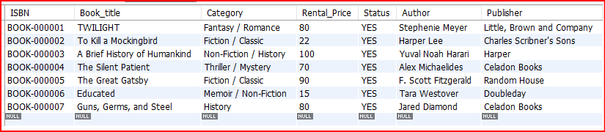

Slide 7
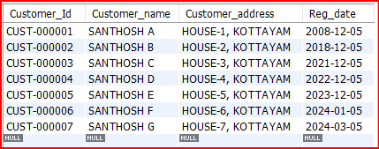
Table : Customer
Attributes for the tables
Customer_Id - Set as PRIMARY KEY, Customer_name, Customer_address, Reg_date
CREATE TABLE Customer( Customer_Id VARCHAR(20) PRIMARY KEY, Customer_name VARCHAR(40) NOT NULL, Customer_address VARCHAR(100) NOT NULL, Reg_date DATE DEFAULT (CURRENT_DATE));
INSERT INTO Customer VALUES
('CUST-000001','SANTHOSH A','HOUSE-1, KOTTAYAM', '2008-12-05'),
('CUST-000002','SANTHOSH B','HOUSE-2, KOTTAYAM', '2018-12-05'),
('CUST-000003','SANTHOSH C','HOUSE-3, KOTTAYAM', '2021-12-05'),
('CUST-000004','SANTHOSH D','HOUSE-4, KOTTAYAM', '2022-12-05'),
('CUST-000005','SANTHOSH E','HOUSE-5, KOTTAYAM', '2023-12-05'),
('CUST-000006','SANTHOSH F','HOUSE-6, KOTTAYAM', '2024-01-05'),
('CUST-000007','SANTHOSH G','HOUSE-7, KOTTAYAM', '2024-03-05');

Slide 8
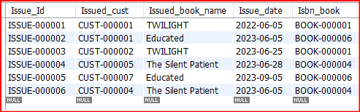
Table : IssueStatus
Attributes for the tables
Issue_Id - Set as PRIMARY KEY, Issued_cust – Set as FOREIGN KEY and it refer customer_id in CUSTOMER table, Issued_book_name, Issue_date, Isbn_book – Set as FOREIGN KEY and it should refer isbn in BOOKS table
CREATE TABLE IssueStatus( Issue_Id VARCHAR(20) PRIMARY KEY, Issued_cust VARCHAR(20), FOREIGN KEY (Issued_cust) REFERENCES Customer(customer_id), Issued_book_name VARCHAR(50), Issue_date DATE DEFAULT (CURRENT_DATE), Isbn_book VARCHAR(20), FOREIGN KEY (Isbn_book) REFERENCES Books(isbn));
INSERT INTO IssueStatus VALUES
('ISSUE-000001','CUST-000001','TWILIGHT','2022-06-05','BOOK-000001’),
  ('ISSUE-000002','CUST-000001','Educated','2023-06-05','BOOK-000006’),
  ('ISSUE-000003','CUST-000002','TWILIGHT','2023-06-25','BOOK-000001’),
  ('ISSUE-000004','CUST-000005','The Silent Patient','2023-06-28','BOOK-000004’),
('ISSUE-000005','CUST-000007','Educated','2023-09-05','BOOK-000006’),
('ISSUE-000006','CUST-000004','The Silent Patient','2023-06-05','BOOK-000004');

Slide 9
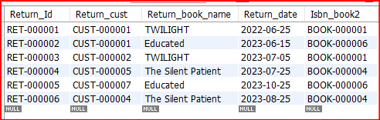
Table : ReturnStatus
Attributes for the tables
Return_Id - Set as PRIMARY KEY, Return_cust, Return_book_name, Return_date, Isbn_book2 - Set as FOREIGN KEY and it should refer isbn in BOOKS table
CREATE TABLE ReturnStatus( Return_Id VARCHAR(20) PRIMARY KEY, Return_cust VARCHAR(20), FOREIGN KEY (Return_cust) REFERENCES Customer(customer_id), Return_book_name VARCHAR(50), Return_date DATE DEFAULT (CURRENT_DATE), Isbn_book2 VARCHAR(20), FOREIGN KEY (Isbn_book2) REFERENCES Books(isbn));
INSERT INTO ReturnStatus VALUES
('RET-000001','CUST-000001','TWILIGHT','2022-06-25','BOOK-000001’),
('RET-000002','CUST-000001','Educated','2023-06-15','BOOK-000006’),
('RET-000003','CUST-000002','TWILIGHT','2023-07-05','BOOK-000001’),
('RET-000004','CUST-000005','The Silent Patient','2023-07-25','BOOK-000004’),
('RET-000005','CUST-000007','Educated','2023-10-25','BOOK-000006’),
('RET-000006','CUST-000004','The Silent Patient','2023-08-25','BOOK-000004');

Slide 10
QUESTIONS

Slide 11
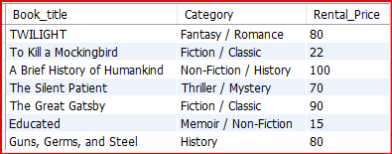
1. Retrieve the book title, category, and rental price of all available books.
SELECT Book_title,Category,Rental_Price FROM Books;

Slide 12
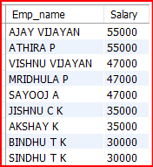
2. List the employee names and their respective salaries in descending order of salary.
SELECT Emp_name, Salary FROM Employee ORDER BY Salary DESC;

Slide 13
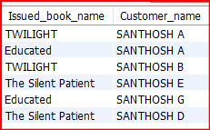
3. Retrieve the book titles and the corresponding customers who have issued those books.
SELECT Issued_book_name, Customer_name FROM IssueStatus LEFT JOIN Customer ON Issued_cust=customer_id;

Slide 14
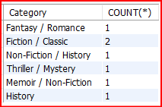
4. Display the total count of books in each category.
SELECT Category, COUNT(*) FROM Books GROUP BY Category;

Slide 15

5. Retrieve the employee names and their positions for the employees whose salaries are above Rs.50,000.
SELECT Emp_name, Position FROM Employee WHERE Salary>50000;

Slide 16

6. List the customer names who registered before 2022-01-01 and have not issued any books yet.
SELECT Customer_name FROM Customer WHERE Customer_Id NOT IN (SELECT Issued_cust FROM IssueStatus) AND Reg_date < '2022-01-01';

Slide 17

7. Display the branch numbers and the total count of employees in each branch.
SELECT Branch_no, COUNT(*) AS 'Employee Count' FROM Employee GROUP BY Branch_no;

Slide 18
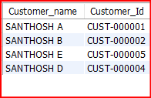
8. Display the names of customers who have issued books in the month of June 2023.
SELECT Customer_name,Customer_Id FROM IssueStatus LEFT JOIN Customer ON Issued_cust=customer_id WHERE Issue_date BETWEEN '2023-06-01' AND '2023-06-30';

Slide 19


9. Retrieve book_title from book table containing history.
SELECT Book_title FROM Books WHERE Book_title LIKE '%history%’;
SELECT Book_title FROM Books WHERE category LIKE '%history%';

Slide 20

10.Retrieve the branch numbers along with the count of employees for branches having more than 5 employees .
SELECT Branch_no, COUNT(*) as 'Employee Count' FROM Employee GROUP BY Branch_no HAVING COUNT(*)>5;

Slide 21

11. Retrieve the names of employees who manage branches and their respective branch addresses.
SELECT Emp_name,Branch_address FROM Branch LEFT JOIN Employee ON Manager_Id=Emp_Id;

Slide 22
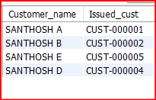
12. Display the names of customers who have issued books with a rental price higher than Rs. 25.
SELECT Customer_name,Issued_cust FROM Customer
RIGHT JOIN IssueStatus ON Issued_cust = Customer_Id
LEFT JOIN Books ON IssueStatus.Isbn_book=Books.ISBN
WHERE Rental_Price>25;

Slide 23
THANK YOU….

